Slide 1

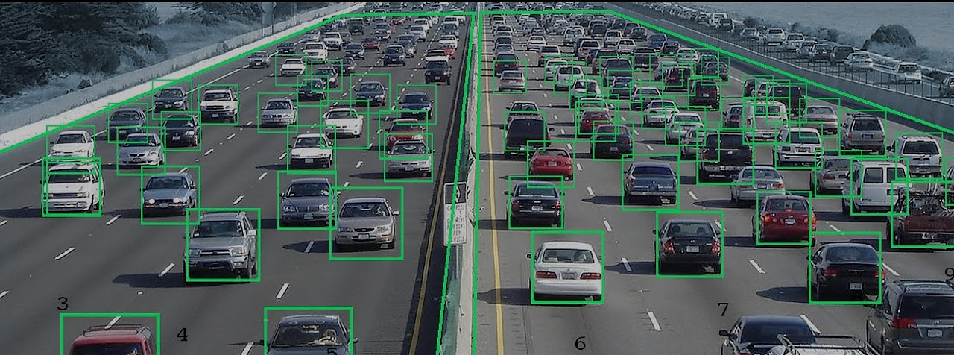
SMART TRAFFIC MONITORING SYSTEM USING YOLO FOR VEHICLE DETECTION AND SPEED ESTIMATION
SUBMITTED BY:- SUBMITTED TO:-
Name:- Shaurya Pundir Mr. Yuvraj Joshi
Section:- AI Assistant Professor
Univ. Roll No. :- 2021975 GEU
Course :- B.Tech CSE (AI)

Slide 2
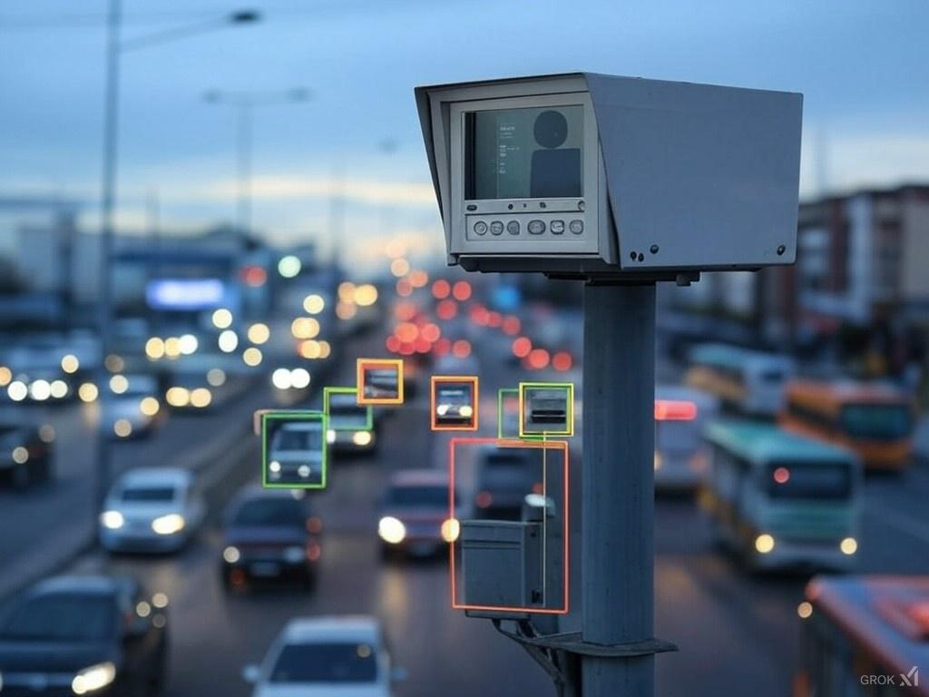
INTRODUCTION
Traffic management in urban areas is a critical challenge, with increasing vehicle numbers contributing to congestion, violations, and safety concerns. Ensuring efficient traffic flow and compliance with laws is essential for modern cities. In recent years, advanced computer vision and AI technologies have revolutionized traffic monitoring. In this project, we explore the innovative Smart Traffic Monitoring System that utilizes YOLOV11 for real-time vehicle detection, speed estimation, and license plate recognition to address these challenges effectively.

Slide 3

PROBLEM STATEMENT
The primary goal of our project is to develop an intelligent system for real-time traffic monitoring and management. Utilizing YOLO for vehicle detection and speed estimation, the system aims to address key challenges such as traffic congestion, speeding violations, and road safety. By analyzing video feeds from traffic cameras, the system can detect vehicles, estimate their speeds, and identify violations like overspeeding. This solution provides actionable insights for traffic management authorities, optimizes traffic flow, enhances safety, and contributes to smarter urban infrastructure planning.

Slide 4

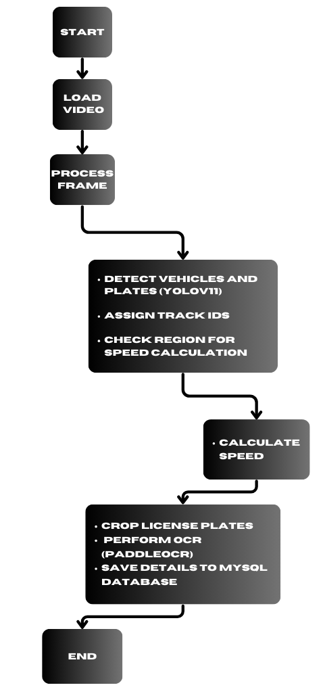
METHODOLOGY
1. INPUT SOURCE & FRAME PROCESSING
Steps in Methodology:
The video is loaded and frames are processed sequentially using OpenCV.
Frames are resized to a standard resolution of 1020x500 pixels.
Function Name in Code:
cap=cv2.VideoCapture('C:/Users/ACER/PycharmProjects/ MINI_Project/tc.mp4')
speed_obj.estimate_speed(frame)
2. OBJECT DETECTION
Steps in Methodology:
YOLOv11 detects vehicles and license plates in each frame.
Outputs include bounding boxes, class labels, and confidence scores.

Slide 5
Function Name in Code:
self.extract_tracks(im0)
self.annotator.box_label(box, label=label, color=colors(track_id, True))
3. OBJECT TRACKING
Steps in Methodology:
Unique Track IDs are assigned to detected objects to maintain continuity across frames.
Tracking IDs are stored in dictionaries like self.trk_pt and self.trk_pp for timestamp and position history.
Function Name in Code:
self.store_tracking_history(track_id, box)
4. SPEED ESTIMATION
Steps in Methodology:
The region of interest is defined (region_points).
Speed= Distance Covered / Time Difference​
Function Name in Code:

Slide 6
self.estimate_speed(im0)
self.LineString([...]).intersects(self.r_s)
5. LICENSE PLATE RECOGNITION
Steps in Methodology:
License plates are cropped based on bounding box coordinates.
OCR is performed on the cropped plates to extract alphanumeric text.
Function Name in Code:
cropped_image = np.array(im0)[y1:y2, x1:x2]
ocr_text = self.perform_ocr(cropped_image)
6. DATABASE LOGGING
Steps in Methodology:
Extracted vehicle data (date, time, speed, license plate, etc.) is stored in a MySQL database.
Duplicate entries are avoided using a set (self.logged_ids).
Function Name in Code:
self.connect_to_db()
self.save_to_database(date, time, track_id, class_name, speed, numberplate)

Slide 7
7. OUTPUT VISUALIZATION
Steps in Methodology:
Bounding boxes, Track IDs, and speed labels are drawn on frames.
Results are displayed in real-time using OpenCV.
Function Name in Code:
self.annotator.box_label(box, label=label, color=colors(track_id, True))
cv2.imshow("RGB", result)

Slide 8
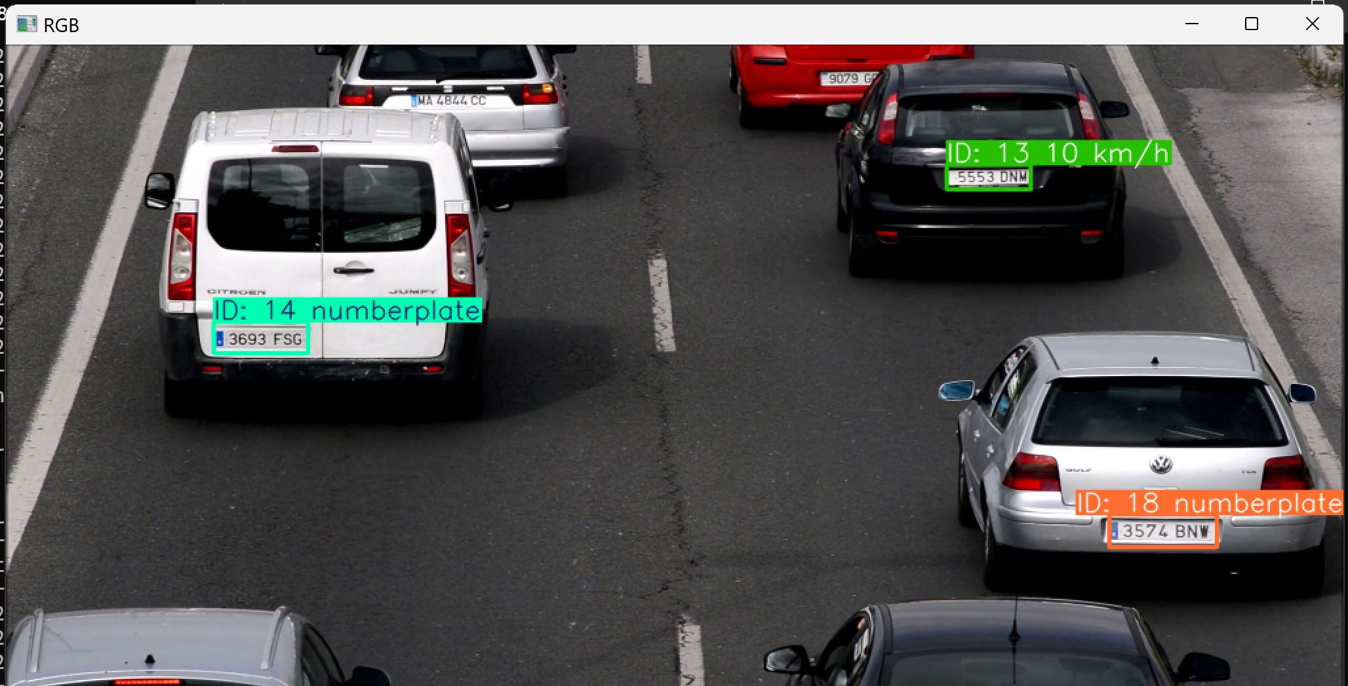
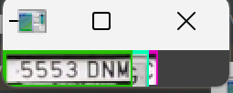
RESULT AND CONCLUSION
All vehicles are successfully detected using their license plates and assigned a unique ID for tracking across frames
When a vehicle reaches the defined region for speed monitoring, the speed is calculated, the license plate is cropped, and the result is sent for OCR processing.

Slide 9
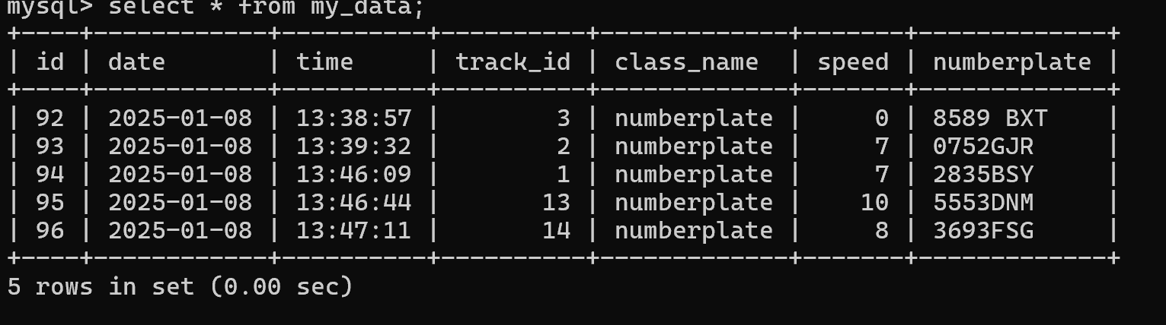
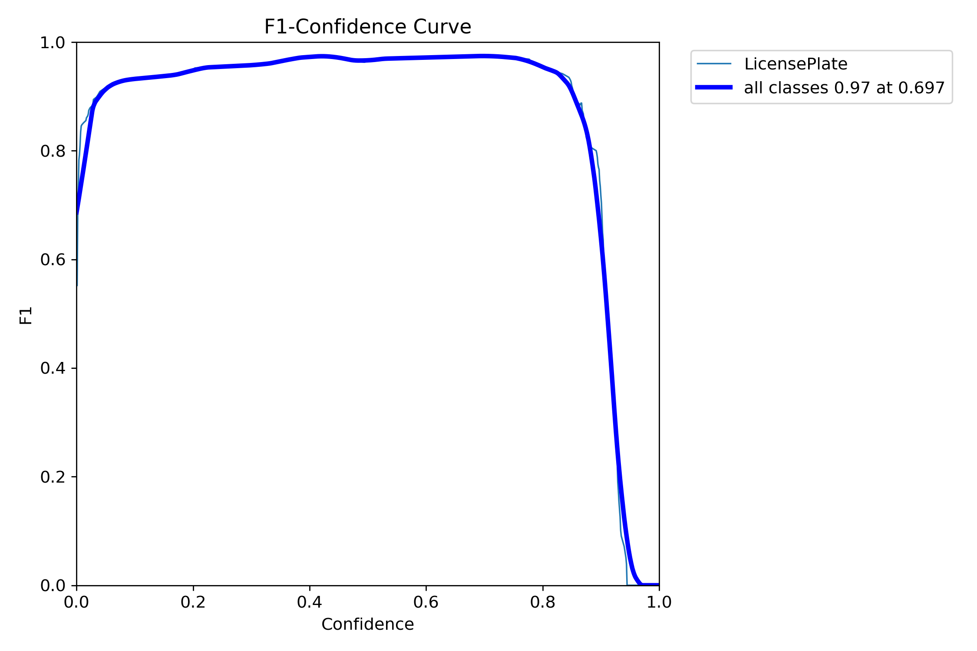


3) The detected license plate number and calculated speed are stored in the MySQL database.
4) License Plate Detection Model Performance:
F1 Score of 0.97 achieved at Confidence Score of 0.697

Slide 10
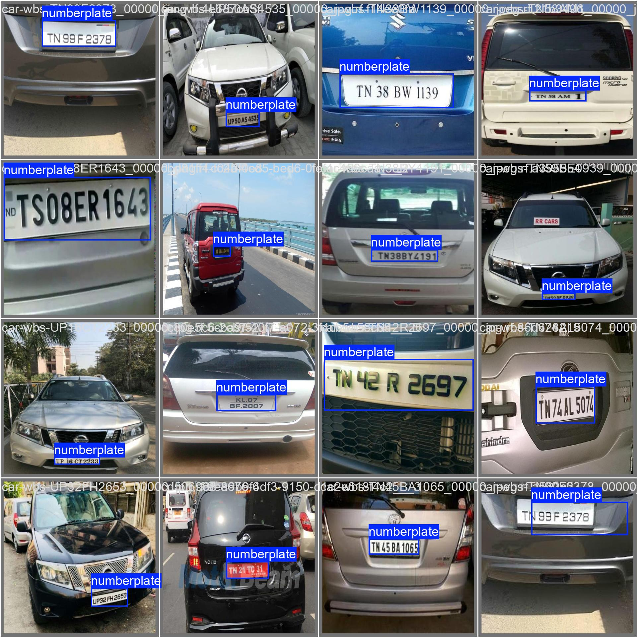
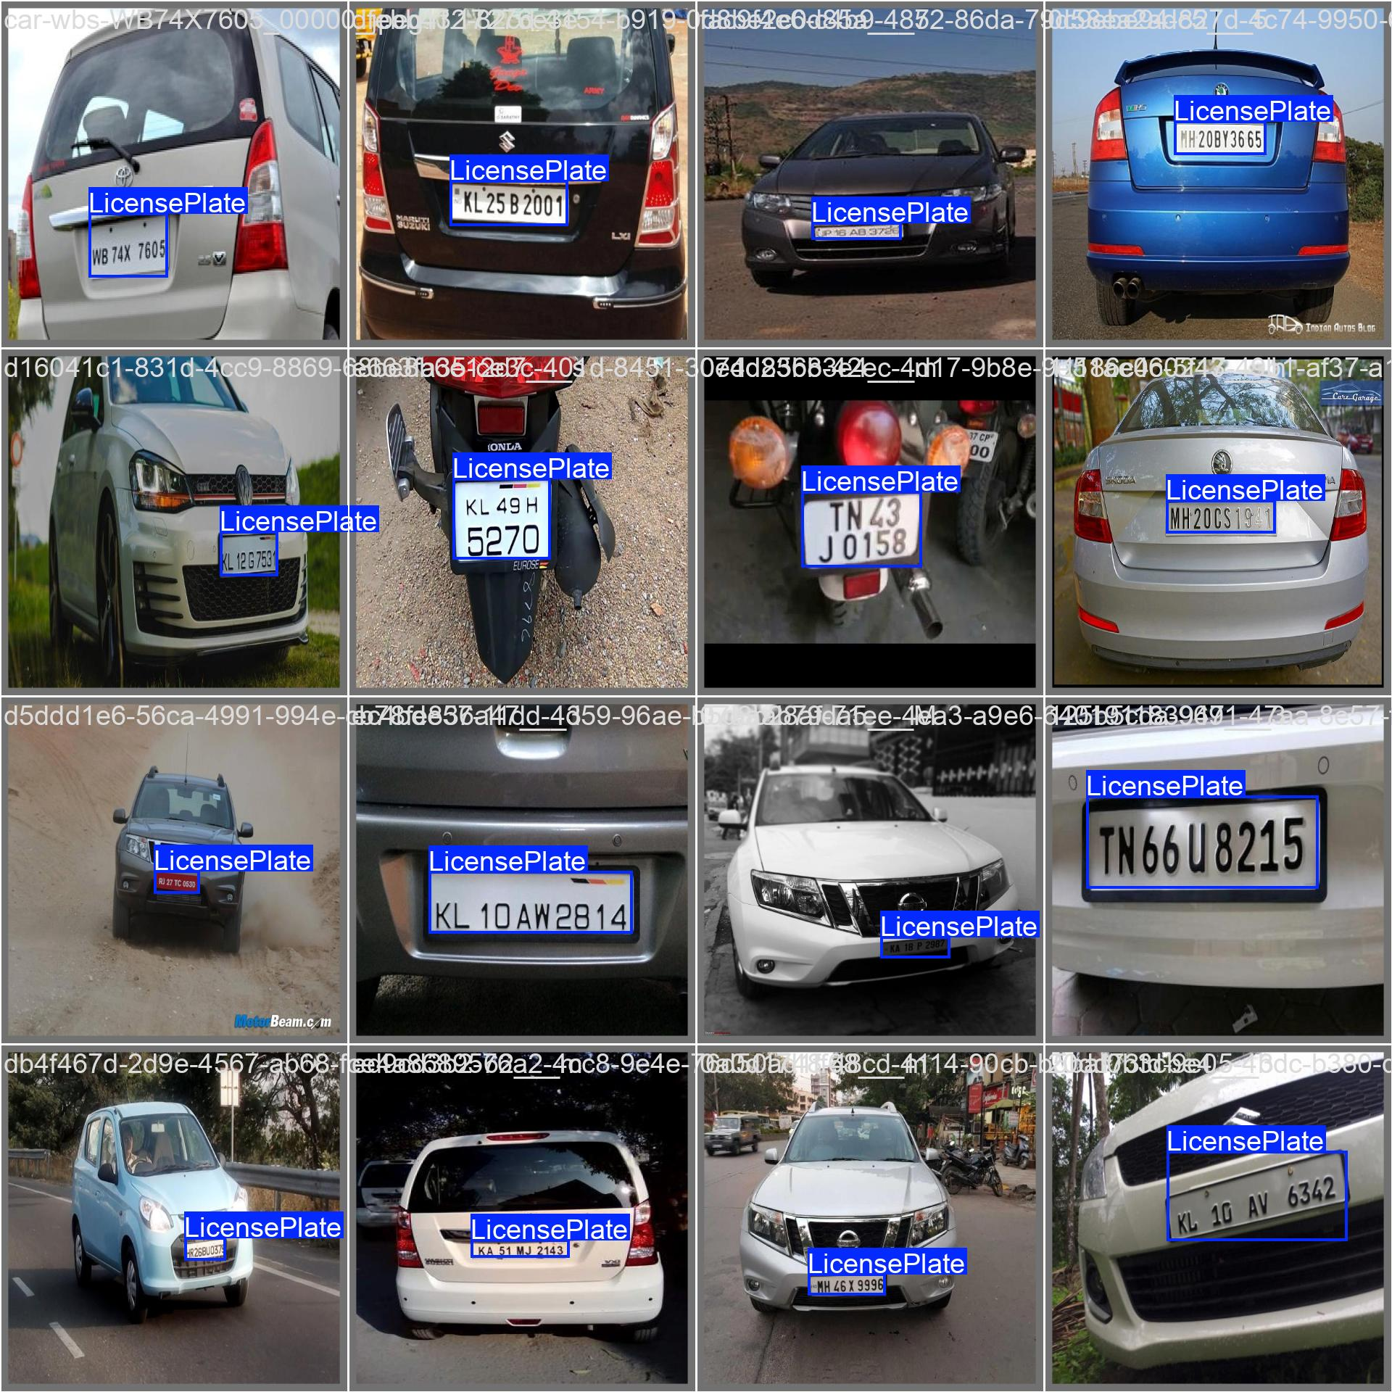
Validation Images:
OCR Success Rate:
OCR Success Rate= (Total Number of Correctly Recognized Plates / Total No of Detected Plates )​×100 ~ 90% (approx.)

Slide 11
CONCLUSION
1) Accurate Detection and Tracking
The fine-tuned YOLO model successfully detects vehicles by their license plates and assigns unique IDs for consistent tracking across frames.
2) Speed Estimation and OCR
Speed estimation is reliably performed when vehicles enter the designated monitoring region.
The license plates are cropped and processed using OCR to extract text, which is then stored in the MySQL database.
3) Efficient Storage
The database maintains high-confidence OCR results for each tracked vehicle, ensuring accurate and organized data for future analysis.
4) Model Performance
Achieved an excellent F1 score of 0.97 at a confidence threshold of 0.697, demonstrating robust precision and recall in the detection process.

Slide 12
Future work
1) Enhanced Accuracy with Diverse Datasets
Fine-tune the model further using datasets with varied lighting, weather, and environmental conditions to improve performance in real-world scenarios.
2) Real-Time Implementation
Deploy the system for real-time traffic monitoring and analysis using video streams from surveillance cameras.
3) Expand Use Cases
Extend functionality to detect and monitor other traffic-related attributes, such as vehicle types, lane violations, and overcrowding.
4) Integration with Edge Devices
Optimize the model for edge devices like Raspberry Pi or NVIDIA Jetson for efficient on-site processing.

Slide 13
THANK YOU

